Slide 1










TRANSFORMATIONS IN WELL-BEING AND RESILIENCE
Harmony in Health has a unique and effective approach to:
Health & well-being and the management of stress
Employee Assistance Initiatives
Supporting your existing occupational health programme
Selection of our clients
Established l996. Now based in Brixham, Devon
Northamptonshire
Fire & Rescue Service
Notes:
Involve you in some practical exercises personal check list
We will be playing musical (NO just kidding) chairs – well moving tables anyway – bear with me on this
Prove
Personal check list handout
MY PERSONAL INTRODUCTION HERE HAVE NOT DONE THAT YET
Lifeworks refocuses attention on effective personal and business coping strategies alongside managing health and wellbeing in order to balance life and work and live In this 24/7 world we inhabit, where change happens quickly, often abruptly.
Ann Bruce works alongside occupational health in small and large organisations. She offers a flexible service, providing one-off support, regular referrals, group support and all the way through to support at case management level.
Her interactive talk will be on the implications upon you and your employees (and offer some solutions) should we experience any (or all) of the following:
Are we in for a winter of discontent?
Expectations to reality
Demands, Loss and Control and the mind and body connection
Emotional resilience and personal performance
Tiredness, lack of vitality and energy depletion
Lifeworks model, from Harmony in Health, is a bridge between theoretical psychological models, counselling in emotional and intuitive intelligence, NLP, life and business coaching, stress management and practical life skills.
Lifeworks refocuses attention on effective personal and business coping strategies alongside managing health and wellbeing in order to balance life and work and live In this 24/7 world we inhabit, where change happens quickly, often abruptly.
Her interactive talk will be on the implications upon you and your employees (and offer some solutions) should we experience any (or all) of the following:
21st century living demands a wholistic approach to living life well, asking us to integrate a new set of life skills where we can be more self-reliant. (which is why we have the five unique aspects to Lifeworks) Understanding HOW change and stress affects you AND what you can do about it for yourself is the foundation (transformation) upon which inner peace, happiness and self-belief are built. AND without those three things transformation cannot happen. ANd without an inner foundation we cannot handle the outer stressors of life, certainly NOT the changes which are currently happening to us all.

Slide 2
ARE WE IN FOR A WINTER OF DISCONTENT?
Expectations to reality
Demands, Loss and Control & Mind/Body Connection
Emotional Resilience & Personal Performance
Tiredness, lack of vitality & energy depletion
Harmony in Health looks at the whole problem and provides a whole solution:
Notes:
What is your reasons for being here..
Feedback…….talk amongst – put up on whiteboard
I have a hypothesis and I’d like to discuss it with you –since l996…… I’ve watched this carefully over the past 3-4 years…..Ican see patterns within my clients inthepast 8 years Ihave had 7500 hours of work with people studying these specific areas
– Particularly over the past few years if we take the BIG PIC
Today we see signs of a world spinning out of balance in the destruction of our ecosystem, in our global economic volatility and significant political changes.
If one wants to explore and understand what these changes might mean, one needs to go within, to where the forces that define our surface life constellate.
– so, I’ve brought my hypothesis here to get your views too – firstly within your specific roles and secondly in a group process where I’dlike to suggest we INTEGRATE your roles – share each other’s experiences, our perceptions – because I’d like to suggest that as never before we need an integrative approach to emotional resilience, health and wellbeing in order to manage our energy levels, age well and maintain our balance and achieve our personal performance in these challenging times….
WE LIVE IN A 24/7 world where change is a constant if your don’t accept there is economic change, political change or climatic change – reflect on changes within your everyday life – evertyhing seems to be full on – mobiles are ceaseless – emails continual (people dread going away because of the email backlog) there does not seem we believe TIME to do anything but react so how can we be in control…….
I’d like to suggest, however that (change has always been a constant) Nothing stays still – I cannot control what is going to happen to me (externally) in 10 minutes time and neither can you……However in the past we have managed that perception by preferring to measure our locus of control externally if you will – measured by material gains, external gratifications, drinking drugs, exercise, eating, watching tv, hobbies, spiritual pursuits, relationships, roles at work in the community…….
Because our 24/7 world is speeding up if you will ……our locus of control is I am suggesting, turning inward ……we are being asked to manage our internal thoughts, emotions, notice our stress symptoms and manage them, accept and learn how to manage our issues around control – anxiety and fears……..and this time it is affecting every single one of us ALL of the time
>>>>>>>>>>>>>>>>>>>>>
Case study on tirenedess lack of vitality and energy depletion – shift work

Slide 3
ARE WE IN FOR A WINTER OF DISCONTENT?
Expectations to Reality
Differing Perception
Don’t we all have expectations?
CHECKING THEM OUT
Changing our Perception - flexibility
On being Assertive – win-win
Assume, Distort, Delete, Generalise
Notes:
SO Expectations to reality –Every single one of us will have a different perception upon a situation/incident or relationships…
.I find this a key issues all of these four are key issues…
.so what do I mean by this……….if you and I witnessed a CAR ACCIDENT our witness statements would be different…
both of us will be affected by what we witnessed
however differently I may feel sick you may have a headache we both might have sleepless nights our thoughts may be going over and over again what happened it might bring up patterns from the past another traffic accident we relive that………ALL OF THIS WILL COLOUR OUR PERCEPTION AND OUR BEHAVIOUR? AND THEREFORE OUR COMMUNICATION OUR TEAMWORK OUR RELATIONSHIPS
Expectations to Reality reflect on expectations v react to the reality of the situation/experience/job/personal challenge?
How often do we ask ourselves take time out to analyse our expectations – lets take a typical example – job interviews/job changes – no of times clients – find their expectations of the job/mgr does not meet the reality…….and what of personal relationships – don’t we all have expectations ???
Yet do we SPECIFICALLY CHECK OUT our expectations with theirs? Arent we either concerned we might not hear what we want to hear – AND it might mean CHSNGING our perception? It might mean being flexible in our outlook in order to achieve a win – win (after all that is what assertive is…...YET here is the problem…..they don’t spent time on reflection check out what is not working for them and then check out the reality with the other person or persons. Preferring to assume what is going on.
CASE STUDY…
Often within expectation to reality we find ourselves……
DISTORT DELETE GENERALISE…….
>>>>>>>>>>>>>>.
Case study on tirenedess lack of vitality and energy depletion – shift work
Lifeworks refocuses attention on effective personal and business coping strategies alongside managing health and wellbeing in order to balance life and work and live In this 24/7 world we inhabit, where change happens quickly, often abruptly.
Her interactive talk will be on the implications upon you and your employees (and offer some solutions) should we experience any (or all) of the following:
21st century living demands a wholistic approach to living life well, asking us to integrate a new set of life skills where we can be more self-reliant. (which is why we have the five unique aspects to Lifeworks) Understanding HOW change and stress affects you AND what you can do about it for yourself is the foundation (transformation) upon which inner peace, happiness and self-belief are built. AND without those three things transformation cannot happen. ANd without an inner foundation we cannot handle the outer stressors of life, certainly NOT the changes which are currently happening to us all.

Slide 4
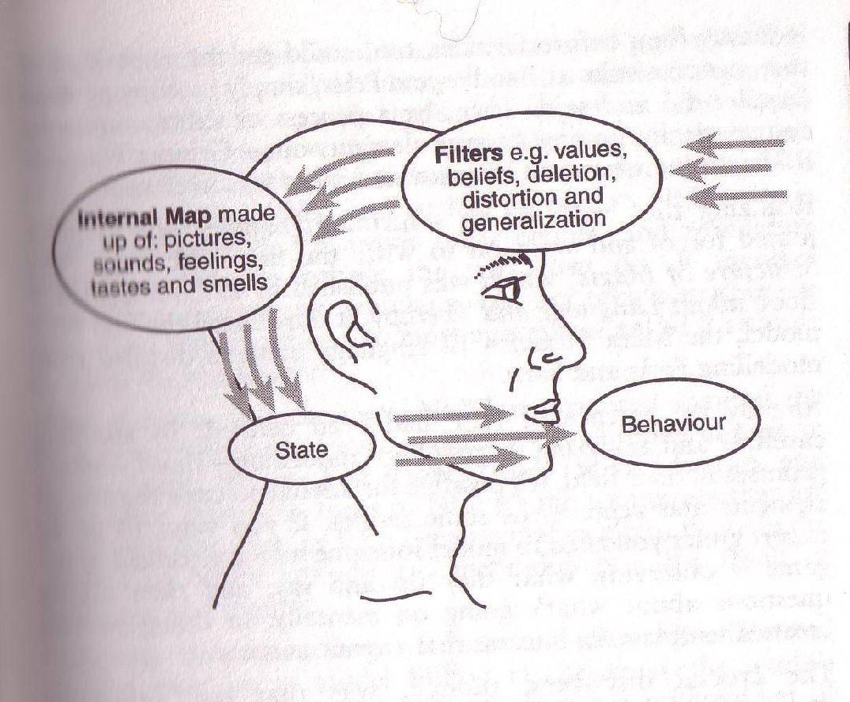
TRANSFORMATIONS IN WELL-BEING AND RESILIENCE
Notes:
DELETE – we miss words out we ASSUME – we don’t listen and refect back to the person what we believe they have said in order to check out what they really did say…..Typical example is in our working role, working alongside others in similar roles we can find ourselves assuming
DISTORTION – distorted by others experiences …..new person to a team – being filled in by others perceptions…..new relationships….other’s views…..the media……people in authority….WE FORGET TO QUESTION to check out whether the emperor has any clothes on >>>
GENERALISE – generallsations in our conversation is HUGE ..couple of example – that’s just typical of the government or ‘that’s management for you’ WATCH out for delete distort and generalisations in your everyday conversations…..
70% body language 23% tone of voice 7% actual words…..PAUL……
.listening….staying in the moment……(not in the past or in the future) drawing on all one’s skills being clear and being still, greatest source of recall, energy and wisdom and perception for what really needs to happen….
STORY of client in siemens incharge of 60 million turnover…..big questions – go and meditate
VALUES and BELIEFS – past patterns installed from childhood peer groups the media….
STORY nurse on accident and emergency – even worked on holiday –presenting issue: exhausted – what was driving him? value instilled by father work ethic always to work. Outcome: balance work with play – lightened up, recognise triggers not judge himself wanting to allow rest and relaxation and fun it was ok to have BOTH
STORY – engineer relationship presenting issue: break down – exhausted angry frightened ……..he needed time to reflect on the breakdown of his relationship, yet he was struggling with getting back to work, he loved his work. He worked well and company is proud of him. We looked at how the relationship had broken down, one particular aspect which was specifically his concern was his value around responsibiity. When he left home at 16 he believed he had to be responsiible for everything, his father had for his family he should do the same. The main reason why in his partner’s eyes the relationship had to break down was because he was never there, he was always working he had no time for her or the family. NOW here is a tricky value – should we not be responsible for our family? Of course we should, but NOT to the detriment of the expectation to the reality of both partner’s needs. In this case, for intimacy and relationship.
Story carry on with him and energy levels put this on the next slide …..
60k THOUGHTS A DAY many negative – many patterns from the past – unless we have trained ourselves in relaxation and meditative ways it is difficult for us to stay in the present…..past/future – hugely affects our stress levels – staying in the present allows us to have a greater perspective a sharper focus and ability to use our right as well as our left brain
WHILST WE ARE ON THOUGHTS – please can I ask you NOT to think of a Pink elephant – blank your mind out or think of what you are doing tonight but just not anything pink or an elephant…..how many of you DIDN’T even for one second think or see a pic of a pink or otherwise elephant? POWERFUL our mind and more importantly in this instance our thoughts –
SO imagine if youa re worried about something, you are anxious – how much that might be prayng in your mind how much that might be affecting your performance whether at work or at home
Lets just consider our five senses for a moment and how powerful they are to us 24/7 yes 24/7 amongst the challenges of life we are bombarded…….
Sight……..pictures evoke a thousand words……lets talk about energy levels for a moment – what sort of picture calms you down…..energises you……..9/11
Sound……
Smell
Taste
Touch
Put all senses together……..how many of you have walked into an office here for example, and senses n ‘atmosphere’……..so how did you sense it?
Example of lemon tree………so what was it a picture, a feeling, the smell of the lemon,,,,when you bit into it,,,the memory of a lemon……..
WOW amazing to be human……….solving your own puzzle

Slide 5
ARE WE IN FOR A WINTER OF DISCONTENT?
Expectations to reality
Demands, Loss and Control & Mind/Body Connection
Emotional Resilience & Personal Performance
Tiredness, lack of vitality & energy depletion
Harmony in Health looks at the whole problem and provides a whole solution:
Notes:
DEMANDS – upon you and me and my abiity to cope? FIRSTLY I really want to emphasise – don’t be too hard on yourself? How many of us were taught these LIFE SKILLS at school?
NOTE: Please don’t give yourself a hard ‘time’ over this. Remember, we were not taught Life Skills at school. 21st Century living demands a wholistic approach to living life well. It asks us to ‘solve our own puzzle’ take responsibility for our health and well-being and integrate a new set of life skills where we can be more resilient and self-reliant. You have more choice than perhaps you realise toward weaving personal and business strategies for living in this 24/7 life in order to manage your anxieties, thoughts and emotions and health issues, so that you can age well and maintain appropriate energy levels.
DEMANDS….. How do I cope when I am experiencing overload or overwhelm? ……..how easy is it for me to STAY in the moment – most of us spend our time in the past (what might have been/ I could have done this differently/give ourselves a bad time – judge ourselves wanting or judge others or we spend our time in the future – wonder whether she will finish this talk on time? I’ve got so much to do this evening….what about that analysis I have to finish by the end of the week……might there be more effective personal strategies for me to adopt in order to get me through my life’s challenges…
CONTROL –
Control: What choices do I have? How am I affected by the structures and controls in my work? In my personal life? How does this affect me mentally, emotionally, physically for example? Do I know? Can I manage my intelligences?
CONTROL – What choices do I have…..How am I affected by the structures and control in my work? ON the BIG pic we are being forced to face the realities of an ecological disaster on a global level, economic issues and political issues – how much choice do I have here? INTERESTINGLY you do have a choice you have a choice how you manage anxiety, fear and stress. Indeed I would go so far as to suggest each and everyone of us has a RESPONSIBILITY toward ourselves here – after all – IT IS MY LIFE AND MY CHOICE isn’t it? (This came home to me when I was living in the States….working on a wellness programme in the community – 1) private health 2) employers/staff/medical prof both in hospital and surgeries worked together 3) personally affected – what can I do for myself? I don’t want to pay those prices – what choices can I make?
So how are these issues around demand and control affecting me – on ALL levels mind/body/
ENERG SLIDE rest assured ……very regularly each and everyone of you will be ‘suffering’ from PRESENTEEISM – present but not functioning 100%
borrow Nicky – we talked about thoughts 60k and how negative thoughts impact – happiest ….saddest moment…
in fact in terms of body rythmns it is impossible to function 100% are you a night owl or a morning lark? What energises you or tires you out? How often do you eat, do you take regular breaks? In fact let me ask you..
………NICKY
>>>>>>>>>>>>>>>>>>>>>>>>>>>
Am I inhibited or constricted? Does this affect my energy levels, creativity, achievements and well-being? What are the implications? In the face of concerns beyond my control (economic, political, environmental) what pulls me through? How do I control my anxieties?
INTERESTINGLY, you do have a choice, you have a choice how you manage your anxiety, fear and stress. Do you choose to react or choose to respond with emotional intelligence? Indeed, at Harmony in Health, we would go so far as to suggest each and everyone of us has a RESPONSIBILITY toward ourselves here – after all – IT IS MY LIFE AND MY CHOICE isn’t it?
(This came home to me when I was living in the States….working on a wellness programme in the community – 1) private health 2) employers/staff/medical prof both in hospital and surgeries worked together 3) personally affected – what can I do for myself? I don’t want to pay those prices – what choices can I make?
……………………….>>>>>>>>>>>>>>>>>>>>
EMOTIONAL RESILIENCE AND PERSONAL PERFORMANCE –
TIREDNESS LACK OF VITALITY AND ENERGY DEPLETION – I’m currently working with a factory worker – relationship breakdown /great worker loves work
Case study on tirenedess lack of vitality and energy depletion – shift work

Slide 6
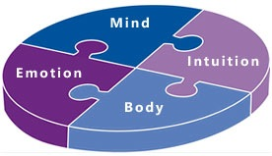
My Life My Choice My Responsibility… … ..Solve Your Own Puzzle
4 Core Intelligences
Notes:
borrow Nicky – we talked about thoughts 60k and how negative thoughts impact – happiest ….saddest moment…
Try it on yourself and your partner….. First stage – relax yourself into the arm of your partner in the knowledge that she/he wont let go ofyour arm…establish that contract….to demonstrate the tension we all have….once established try the exercise yourself….
Please don’t give yourself a hard ‘time’ over this. Remember, we were not taught Life Skills at school. 21st Century living demands a wholistic approach to living life well. It asks us to ‘solve our own puzzle’ take responsibility for our health and well-being and integrate a new set of life skills where we can be more resilient and self-reliant. You have more choice than perhaps you realise toward weaving personal and business strategies for living in this 24/7 life in order to manage your anxieties, thoughts and emotions and health issues, so that you can age well and maintain appropriate energy levels.
My Life My choice – where we all become more self-reliant and pro-active on our wellbeing - When we take a whollistic view of ourselves in the recognition that all intelligences are connected we will see ourselves differently – we will see what works well, what can I do differently (using and listening t all four intelligences) in order to respond rather than react to the changes going on in your work and in your oersonal life.
Do I know my triggers? CAR – BEEPIBG….manaager who intuitively with gut feel felt a problem with this new member of staff -
do I know my mental triggers –
my emotions –
my physical –
Where does mnd stop and body begin cant eat ÉCLAIR……
JOINT EXERCISE ….common problem …now lets prove our mind and body connection through another exercise – how many of you suffer from tension – neck or shoulder tension> or the lemon tree……
that initiated by the mind or the body or my emotions – they are all part of me aren’t they? YET I HAVE NO LIFE SKILLS everything happens so fast………….doesnt it ………imagine when there is an irate customer on the end of the line…..there is a breakdown in team dynamics in the office…..tension to meet a deadline……..tension at home……….can we manage it? What is happening to our m/b/i/e/ are we aware of our triggers what do we do to bring down our anxiety levels……
GRANT bit of proof here …. Implications to our health and wellbeing if we stay at high anxiety –body is in flight and fight it doesn’t relax or recover… healthy to go up and down – stress changes the blood from an alkaline to an acidic – acid just like a battery in a car if it is prolonged in the body will corrode the organs nerves it will also corrode our emotions and thoughts – we become lethargic, sleepy, sleepless, anxious, unable to eat, wanting to eat more and so on….
NEW LIVER STOMACH LINING 7 DAYS SKELETON CHANGES IN 5 YEARS….
Solving own puzzle taking responsibiity for your health - sense of how wholistic our thinking needs to be…
Emotional Resilience and personal performance at work and at home……..we want to have sufficient energy levels…..

Slide 7
ARE WE IN FOR A WINTER OF DISCONTENT?
Expectations to reality
Demands, Loss and Control & Mind/Body Connection
Emotional Resilience & Personal Performance
Tiredness, lack of vitality & energy depletion
Harmony in Health looks at the whole problem and provides a whole solution:
Notes:
EMOTIONAL RESILIENCE AND PERSONAL PERFORMANCE –
TIREDNESS LACK OF VITALITY AND ENERGY DEPLETION – I’m currently working with a factory worker – relationship breakdown /great worker loves work
Case study on tirenedess lack of vitality and energy depletion – shift work

Slide 8
EMOTIONAL RESILIENCE & PERSONAL PERFORMANCE
Managing change within yourself
Ideally staying 50% in your Foundation Zone continuously strengthening your skills
Explore
My Potential
When foundation is strong you will
naturally want to
stretch yourself
OUTER WORLD
Align with your full
potential - coming into personal power. Who am I really? What makes my heart sing?
INNER WORLD Inner Resource and Foundation. Wellbeing, Life Skills. The
Four I’s. Goals and dreams. Consistency and
performance.
PANIC ZONE
out of control – place of trauma, mid life crisis, lack of life skills & inner world
resources
Comfort
Zone
Emotional Resilience
What pulled me into panic zone?
Reflect on inner resource and strengthen foundation.
Notes:
STARTING POINT OF ALL ACHIEVEMENT IS DESIRE FOR THAT WE NEED TO CREATE A MOVEMENT TOWARDS…WE NEED TO CREATE A FOUNDATION ZONE FOR OURSELVES WHERE WE STAY 50% OF THE TIME AND A STRETCH ZONE WITH A WILLINGNES TOMOVE 50% OF THE TIME.
Anyone play golf?
Anyone who doesn’t play golf not seen someone playing golf?
EXAMPLE of practise and commitment and responsibility and choice….
Emotional Resilience & Personal Performance…CAPACITY TO CHANGE…CONFIDENCE TO CHANGE…WILL TO CHANGE…BEHAVIOUR TOWARD CHANGE
Tiredness, lack of vitality & energy depletion
STORY nurse on accident and emergency – even worked on holiday –presenting issue: exhausted – what was driving him? value instilled by father work ethic always to work. Outcome: balance work with play – lightened up, recognise triggers not judge himself wanting to allow rest and relaxation and fun it was ok to have BOTH
Story carry on with him and energy levels put this on the next slide ….. I want my energy back (working through emotions reduces our energy/ eating wrong food reduces our energy….
BRAINSTORM – what enhances what depletes your energy levels……..now ask you yourselves in your roles at work…..what enhances what depletes
STORY – engineer relationship presenting issue: break down – exhausted angry frightened ……..he needed time to reflect on the breakdown of his relationship, yet he was struggling with getting back to work, he loved his work. He worked well and company is proud of him. We looked at how the relationship had broken down, one particular aspect which was specifically his concern was his value around responsibiity. When he left home at 16 he believed he had to be responsiible for everything, his father had for his family he should do the same. The main reason why in his partner’s eyes the relationship had to break down was because he was never there, he was always working he had no time for her or the family. NOW here is a tricky value – should we not be responsible for our family? Of course we should, but NOT to the detriment of the expectation to the reality of both partner’s needs. In this case, for intimacy and relationship.
SO imagine if youa re worried about something, you are anxious – how much that might be prayng in your mind how much that might be affecting your performance whether at work or at home – what might it do to energy levels…remember the pink elephant..60ooo thoughts 60ooo pink elephants….have you heard of the elephant in the room story?
Lets just consider our five senses for a moment and how powerful they are to us 24/7 yes 24/7 amongst the challenges of life we are bombarded…….
Sight/sound/smell/taste/touch……..pictures evoke a thousand words……lets talk about energy levels for a moment – what sort of picture calms you down…..energises you……..9/11
BRAINTSTORM ENERGY – we cant stay in the foundation lack of foundation means lack of energy strong foundation we can nurture ourselves from a dry well or resource ourselvews
My Life My choice – where we all become more self-reliant and pro-active on our wellbeing - When we take a whollistic view of ourselves in the recognition that all intelligences are connected we will see ourselves differently – we will see what works well, what can I do differently (using and listening t all four intelligences) in order to respond rather than react to the changes going on in your work and in your oersonal life.
We may have different roles – we will have differing perspectives – yet as you have seen today – at the very core – we are very similar! Taking time to step back, see big pic, other perspectives, stay in the moment, manage your own stress symptoms in the recognition we are all undergoing similar experiences –
Where we all work together in the recognition that – at the very core – we are all the same – our puzzles may be different – our journey to put together our puzzle will be different – we all have different perspective on life – yet at the core – in order to have a strong foundation to manage the ups and downs of life – accept that the only moment we can control is the NOW moment
Tiredness lack of vitality and energy depletion WILL have an ffect on health, wellbeing and issues of ageing.

Slide 9
ARE WE IN FOR A WINTER OF DISCONTENT?
What is your perception?
What is your experience (personally and in your role)
Expectations to reality
Demands, Loss and Control & Mind/Body Connection
Emotional Resilience & Personal Performance
Tiredness, lack of vitality & energy depletion
Notes:
Businesses short term have to be long term in the future employer to look after employee – what I can say a responsibility integrative approach which requires all employees to take responsibiity as individuals and as an integrative approach within their roles……and that’s why I am asking for your feedback – firtl within your role what is your perception are we in for a winter of discontent – or perhaps even longer may be going all next year or even longer…..

Slide 10
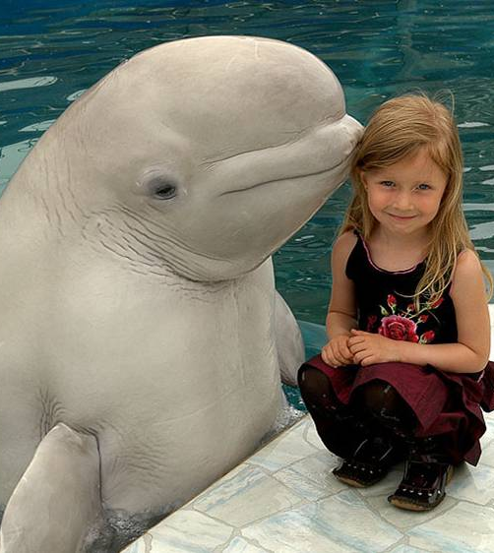
Coffee Time!
Notes:
On different perception been notes on your own personal checklist – what would be helpful – mix up grops – together in differing roles and to dsicuss your what manage health and wellbeing personnally or within your team department or organisaiton.
Feedback on whiteboard – chat through – Q and Answers

Slide 11

Time for a Mix Up!
Share Your Views of today
Listen to others in different roles
Ask yourself:
What would work well?
How can we work together?
Notes:
On different perception been notes on your own personal checklist – what would be helpful – mix up grops – together in differing roles and to dsicuss your what manage health and wellbeing personnally or within your team department or organisaiton.
Feedback on whiteboard – chat through – Q and Answers

Slide 12
Harmony in Health Core Process
Integrated: | Combined approaches - no two people are alike.
Wholistic: | The whole problem - a whole solution
Process: | We help people adapt to, and keep learning from, change
Transformation: | Enables people to move beyond their original limits
Solving Your Own Puzzle: | We guide people on their individual journey – they tap into their own unique inner resource.
Notes:
Implication we are responsible for our own journey – solving our own puzzle … it is my life I cant be the vicitim of circumstances or balme others (DR chairlift) that means I have to take respon for my emotional world resp health wellbeing resp for my boundaries and asserting my needs…and within the work enviroment.
That is Harmony in Health 5 unique aspects to looking at yourself wholistically………..it is about Empoerment is the ultimate aims……of the process….
Winter discontent – fracturered feel work doesn’t liove them anywmore through the transition need to become stronger more better off…..
21st century whole new set of life skills – we saw that at harmony back in l980’s study states wellness in the community hence harmony’s unique approach

Slide 13
My Life My Choice My Responsibility…
…….Solve Your Own Puzzle
Better Choices
Take responsibility
Become empowered
…And Solve Your Own Puzzle
NLP
Life and Business Coaching
Counselling
Stress management
Practical life skills
Notes:
USE MY LEAFLET AND HAVE COPIES IN PLASTIC FOLDERS
How do e as HIH enable people to make better choices take respo become empowered and solve their own puzzle - these are the skills we use to get the outcome.
Solving your own puzzle – you need to become empowered - responsibility and empowerment needs to be embedded…….and choices new or different they need to make…that is one of the core aims one would be taking them trhough …..concluding with that……
The ways we work
(for taking responsibility and making effective choices)
NOW isnt this interesting ? 5 unique aspects to the process and 5 integrative skills within the service - ALL IN ONE PACKAGE........got to save money AND time in referrals from thr management perspective
Got to be a USP.....A manager who wants his staff to stay at work, be effective, take initiative remain creative and still achieve on time needs his staff to manage their energy levels, understand their stress sysmptos, manage them, try where possible to pre-empt problems when they experience even one trigger / symptom. Be effective in their communication with peers, subordinates, and with clients/patients, manage conflict with others and within themselves, STILL create visions, move forward toward goals and ensure effective strategies are maintained,

Slide 14
Notes:
Overview – expect to reality……
My sense for their own individual as well as teams
These are different processes - team line manager or HR……..
By pass if not relevant – allude to it if you are a manager and Oh pls contact us

Slide 15
TRANSFORMATIONS IN WELL-BEING AND RESILIENCE
Harmony Circles
LifeWORKS Does It For You?
Join one of our circles
LifeWORKS Individual Process
Intensive, short term, one to one sessions, designed to restore individual resilience and well-being.
LifeWORKS Group Process
Develop coping strategies around change, to improve health, well-being and performance.
HealthWORKS Group Coaching
Make informed choices about managing my energy, health, wellbeing and ageing well.
Early Intervention Initiatives
A menu of ad-hoc support services for proactively building healthy resilience & well-being into your organisation.
Employee Assistance Programmes
21st century living demands life skills where we all become more self-reliant and pro-active in our wellbeing

Slide 16
TRANSFORMATIONS IN WELL-BEING AND RESILIENCE
21st Century Living demands a new set of Life Skills
My Life, My Choice, My Responsibility
Coming into Unity and Community
Manage my energy, health, wellbeing and age well….
Notes:
Four contrite responsible successful learner and confidence to achieve all above
My Life My choice – where we all become more self-reliant and pro-active on our wellbeing - When we take a whollistic view of ourselves in the recognition that all intelligences are connected we will see ourselves differently – we will see what works well, what can I do differently (using and listening t all four intelligences) in order to respond rather than react to the changes going on in your work and in your oersonal life.
LifeWORKS provide the building blocks for an organization to work together effectively, because it encourages responsibility, empowerment and choice in the individual.
We may have different roles – we will have differing perspectives – yet as you have seen today – at the very core – we are very similar! Taking time to step back, see big pic, other perspectives, stay in the moment, manage your own stress symptoms in the recognition we are all undergoing similar experiences –
Where we all work together in the recognition that – at the very core – we are all the same – our puzzles may be different – our journey to put together our puzzle will be different – we all have different perspective on life – yet at the core – in order to have a strong foundation to manage the ups and downs of life – accept that the only moment we can control is the NOW moment
Tiredness lack of vitality and energy depletion WILL have an ffect on health, wellbeing and issues of ageing.
21st century living demands a wholistic approach to living life well, asking us to integrate a new set of life skills where we can be more self-reliant. (which is why we have the five unique aspects to Lifeworks) Understanding HOW change and stress affects you AND what you can do about it for yourself is the foundation (transformation) upon which inner peace, happiness and self-belief are built. AND without those three things transformation cannot happen. ANd without an inner foundation we cannot handle the outer stressors of life, certainly NOT the changes which are currently happening to us all.
practical life skills (because their health, their longevity and their energy is their responsibility)
LifeWORKS refocuses attention on an wholistic and individual wellbeing strategy, encouraging each person (using coaching as the foundation) to take responsibility and make informed choices in managing their health, longevity and energy processes( in the awareness that all intelligences (mental,physical, emotional and intuition) will have a direct affect on them and all aspects of their life). The outcome of managing one's health naturally is a long-term strategy (inner foundation) for coping effectively with work and life pressure and personal and work relationships.
Talk about my experience in the STATEs on wellness programmes hospitals, drs surgeries, organisations, individuals coming together
South west water – going with the flow……manifesting fear or happiness (see my leaflet – without the flow

